Slide 1






2025 IEEE iSSSC
2025 IEEE 3rd International Symposium on Sustainable Energy, Signal Processing & CyberSecurity
Paper Title: Enhanced Multi-Zonal Forest Type Classification Using YOLOv8 and EuroSAT for Scalable Environmental Monitoring
Paper ID: 637 Presenter Name: Nakka Vijay Bhaskar Reddy
Authors: Nakka Vijay Bhasker Reddy, Moturi Sirisha, Nagaram Prasad Rao,
Mundlamuri Vijaya Kumarachari, Dodda Venkata Reddy
Affiliation: Department of CSE,Narasaraopeta Engineering College ,Andhra pradesh , India

Slide 2







Outline
Introduction (try to answer what it is, why it is, and what is (are) existing problems, why the problem is so important to discuss; may cite in the footer)
Motivation & Contributions
Proposed System Model Results and Discussion Conclusion
Reference

Slide 3
Introduction
Forests are essential for maintaining climate balance, biodiversity, and carbon storage.
Monitoring forest stands supports sustainable management and early detection of
environmental changes.
Traditional methods like field surveys and aerial photography are accurate but slow and costly on large scales.
With Earth Observation satellites and Artificial Intelligence, automated forest detection is now possible.
This study develops a YOLOv8-based system using the Euro SAT dataset for efficient and real-time forest classification.

Slide 4
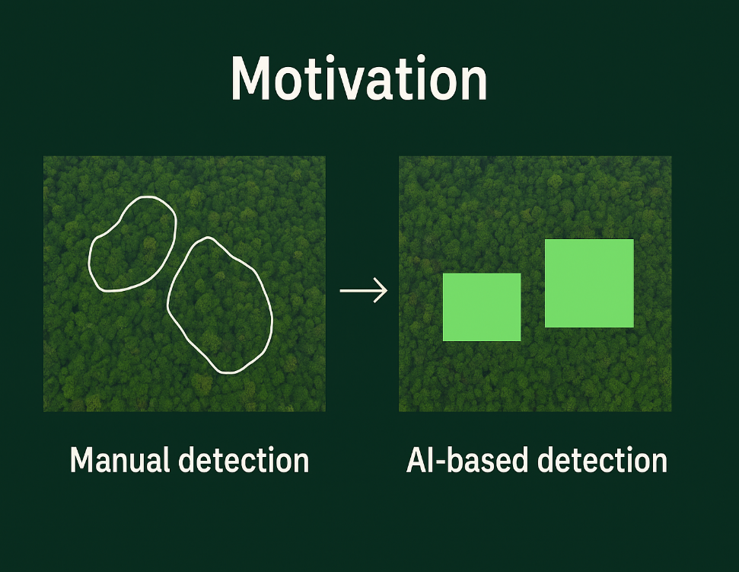
Motivation & Core Contribution
Forest monitoring needs faster and more accurate methods for large-scale environmental analysis.
Existing models like EfficientNet and CNNs provide good accuracy but lack real-time processing efficiency.
YOLOv8 offers a lightweight and high-speed deep learning architecture suitable for satellite images classification.
This study introduces a multi-zonal forest classification system using the YOLOv8 framework and EuroSAT dataset.
The model achieves 97.5% accuracy, proving effective for scalable and real-time forest monitoring applications.

Slide 5
Literature Review
Previous studies used deep learning models like YOLOv5, Mask R-CNN, and EfficientNet for forest detection and classification.
These models achieved good accuracy but often required high computational power and long training times.
Some works focused on forest fire detection and deforestation alerts, showing the potential of AI in environmental monitoring.
Only a few studies have applied advanced YOLOv8 models specifically for detailed forest type classification.
This work tries new model combinations and improved preprocessing to achieve better accuracy and faster performance.

Slide 6
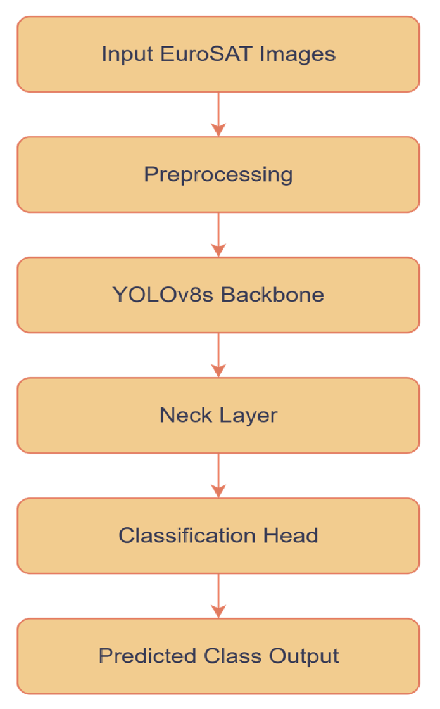
Proposed System Model
The model used in this study is YOLOv8, a fast and lightweight deep learning architecture.
It is designed mainly for real-time object detection but also supports image classification tasks.
The architecture includes a backbone to extract image features, a neck to combine multi-scale features, and a head that outputs class predictions.
The model learns to identify different land-cover types by analyzing spatial and spectral patterns in the images.
YOLOv8 was selected because it delivers high accuracy with faster processing, making it ideal for large-scale forest classification.

Slide 7
Simulation Setup
The EuroSAT dataset was divided into 70% for training, 15% for validation, and 15% for testing.
Images were normalized and augmented through flipping and rotation to improve model generalization.
The YOLOv8 model was trained for 30 epochs using the Adam optimizer with a learning rate of 0.001.
Cross-entropy loss was used to measure classification accuracy and guide model learning.
Model performance was evaluated using accuracy, precision, recall, and F1-score metrics.

Slide 8
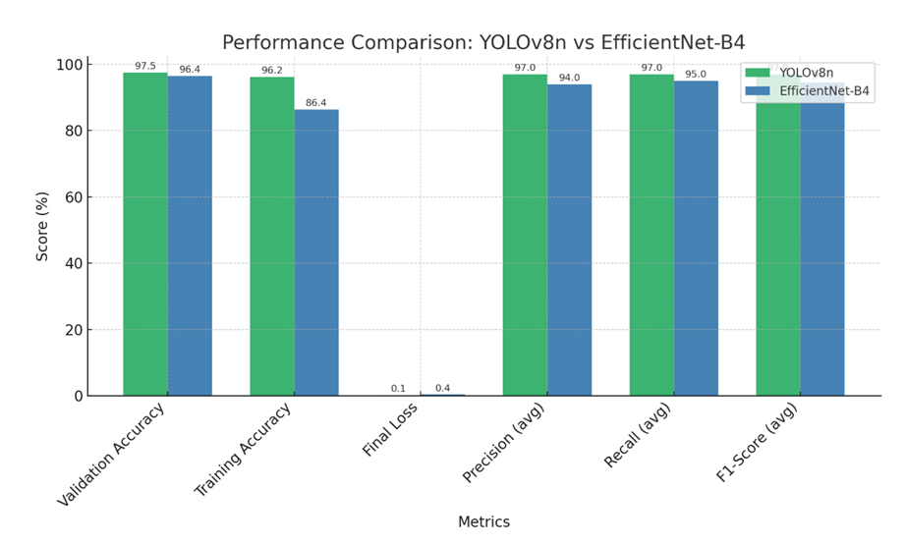
Result and Discussion
The YOLOv8 model achieved an overall accuracy of 97.5% on the EuroSAT dataset.
Precision, recall, and F1-score were 97.8%, 98.2%, and 97.8%, showing consistent performance across all classes.
YOLOv8 outperformed EfficientNet-B4 in both accuracy and processing speed, making it suitable for real-time use.
Data augmentation and parameter tuning improved the model’s stability and reduced overfitting.
The results show that YOLOv8 can accurately classify multiple land-cover types, proving effective for scalable forest monitoring.

Slide 9
Conclusion & Future Work
The study developed a multi-zonal forest classification system using the YOLOv8 model and the EuroSAT dataset.
The model achieved high accuracy and fast processing, proving effective for real-time forest monitoring.
YOLOv8 performed better than EfficientNet-B4 while using fewer computational resources.
The approach supports large-scale environmental analysis and sustainable forest management.
Future work will focus on expanding the dataset and optimizing the model for better regional generalization and real-time deployment.

Slide 10
References
Saricayir and Ozcan (2025): EfficientNet deep learning model for satellite image classification using the EuroSAT dataset.
Amani et al. (2023): Deep transfer learning-based forest fire susceptibility mapping using satellite imagery.
Lu et al. (2022): UAV and deep learning-based forest fire detection and early warning system.
Kovacovic et al. (2025): Satellite-based forest stand detection using artificial intelligence.
Corley et al. (2025): Landsat-Bench datasets and benchmarks for Landsat foundation models.

Slide 11
Reviewer Comments Addressed
Enhanced English Proficiency: Improved grammar, clarity, and overall academic tone across the manuscript.
Improved Figures and Tables: Added high-quality figures and new tables for hyperparameters and runtime comparison.
Expanded Methodology: Provided detailed explanations of the YOLOv8 architecture, training setup, and preprocessing.
Added Comparative Analysis: Included performance comparison between YOLOv8 variants and EfficientNet-B4, highlighting efficiency and scalability.
Extended Discussion and Future Work: Discussed misclassifications, Expanded limitations, future research scope, and practical deployment potential for real-time forest monitoring.

Slide 12
Thank You

